Slide 1
Lead Scoring Case Study using logistic regression model
Submitted by :
Vinod Yadav
Vignesh Kumar
Ujjwal Verma

Slide 2
Outline
Executive Summary
Introduction
Methodology
Results
Conclusion

Slide 3
Executive Summary
Summary of methodologies
Data Collection
Exploratory Data Analysis
Identifying Categorical Variables and Creating Dummy Variables
Model Building Using Logistic Regression
Prediction on Test Dataset
Conclusion
Summary of results
Data Analysis along with Interactive Visualizations
Conclusion and recommendations

Slide 4
introduction
Problem Statement
An education company named X Education sells online courses to industry professionals. On any given day, many professionals who are interested in the courses land on their website and browse for courses.
Company markets its courses on several websites and search engines like Google. Once these people land on the website, they might browse the courses or fill up a form for the course or watch some videos. When these people fill up a form providing their email address or phone number, they are classified to be a lead. Moreover, the company also gets leads through past referrals. Once these leads are acquired, employees from the sales team start making calls, writing emails, etc. Through this process, some of the leads get converted while most do not. The typical lead conversion rate at X education is around 30%.
Although X Education gets a lot of leads, its lead conversion rate is very poor. For example, if, say, they acquire 100 leads in a day, only about 30 of them are converted. To make this process more efficient, the company wishes to identify the most potential leads, also known as ‘Hot Leads’. If they successfully identify this set of leads, the lead conversion rate should go up as the sales team will now be focusing more on communicating with the potential leads rather than making calls to everyone.

Slide 5
introduction
Goals of the Case Study:
To build a logistic regression model to assign a lead score between 0 and 100 to each of the leads which can be used by the company to target potential leads.
To adjust to if the company's requirement changes in the future so you will need to handle these as well.

Slide 6
Methodology
Goals of the Case Study:
Data Preprocessing
Data Visualization
Model Training
Metrics Comparison
Prediction on Test data
Conclusion

Slide 7
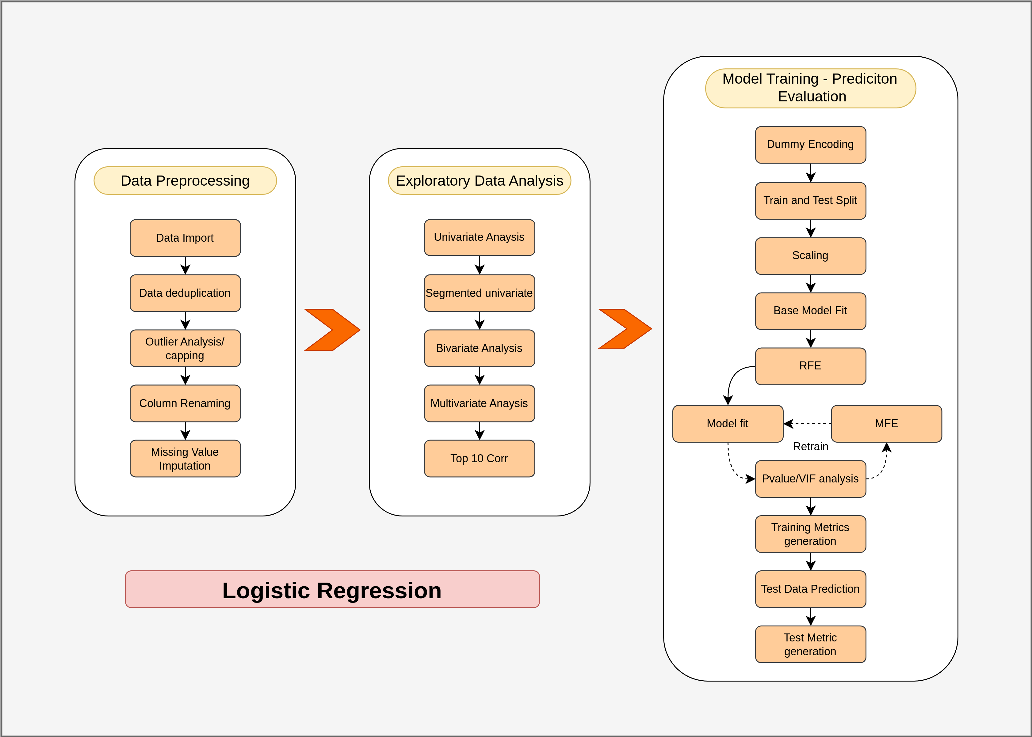
logistic regression overview
Steps in logistic regression model

Slide 8
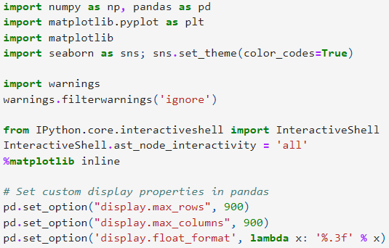
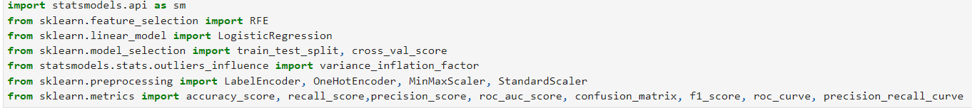
Data Preprocessing
1. Package Imports and Data Initialization
With this code we have imported all libraries numpy, pandas, matplotlib, seaborn.
With below mentioned code We have imported necessary machine learning packages (sklearn, statsmodel) for performing logistic regression

Slide 9

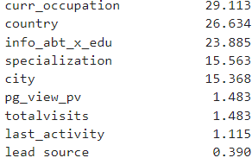
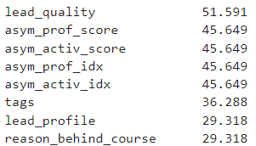
Data Preprocessing
We have created Custom Functions for Preprocessing and EDA
def classify_feature_dtype(df, cols):
def show_stats(df, cols):
def check_cols_null_pct(df):
def univariate_plots(df, cols, target=None, ftype=None, l_dict = None):
def get_extremeval_threshld(df, find_outlier=False)
With the below mentioned code we have drop unnecessary columns
#below mentioned code will give us the shape and size of the data frame
# With the below mentioned code we have# checked null val percentage
# After checking the null value percentage for all the features
# We could see that there are many features that have more than 40% of non values

Slide 10
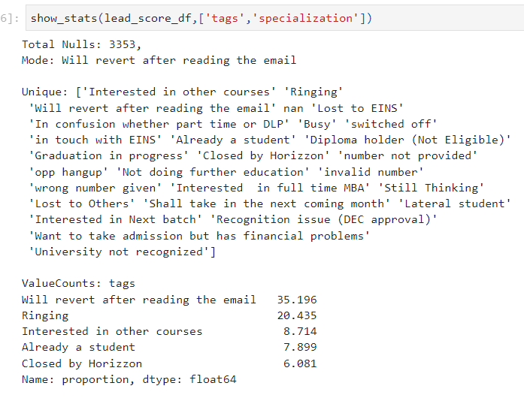
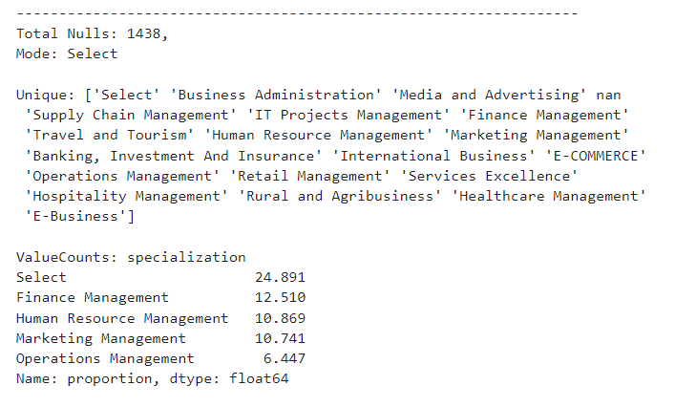
Data Preprocessing
In Tags and and specialization we have replaced select and nan values with unknown, and remove the unknown values after doing dummification

Slide 11
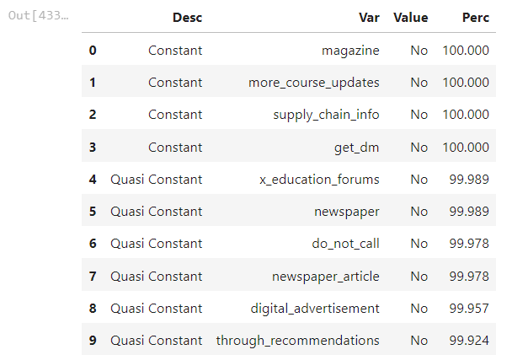
Data Preprocessing
Below mentioned code has replace select string with nan
We have checked constant features that has only one values
In the given data set there are a lot of features that have only single value as a category
These are called as constant features and these features are of little relevance for the machine learning model hence we have dropped those features which have Constant Feature Identification
impute missing categorical values using mode, if a particular value in that column has higher frequency say > 50%
After completing eda we got four more columns which are having less than 2 % of null values , so we will drop the rows from those columns ( ‘Totalvisits’,’pg_view_pg’,’last_activity’,’lead_source’)

Slide 12
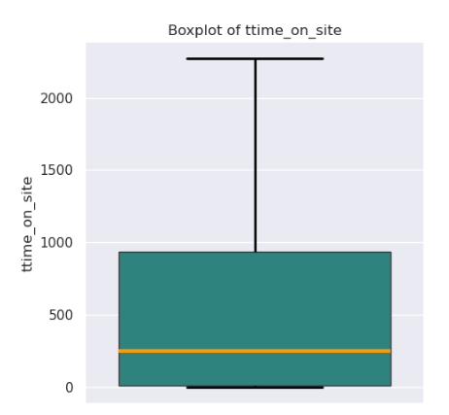
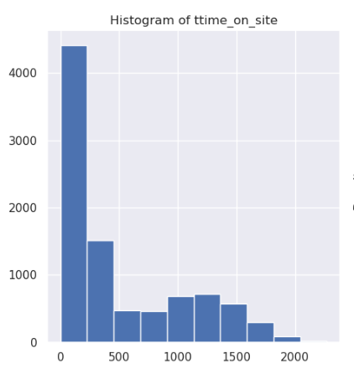
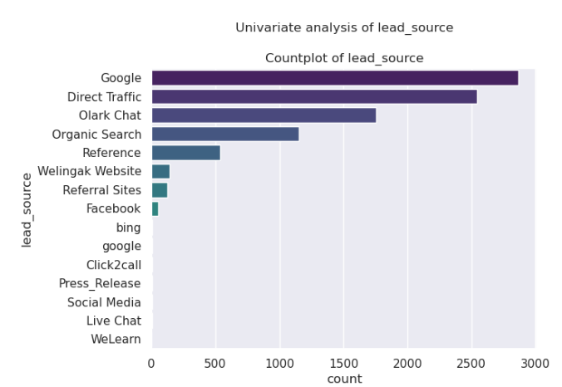
Data Visualization
univariate plots
When it comes to lead source 30% are from google, 27% are from direct traffic, 19% are from olark

Slide 13
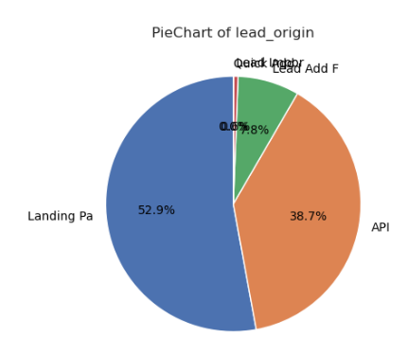
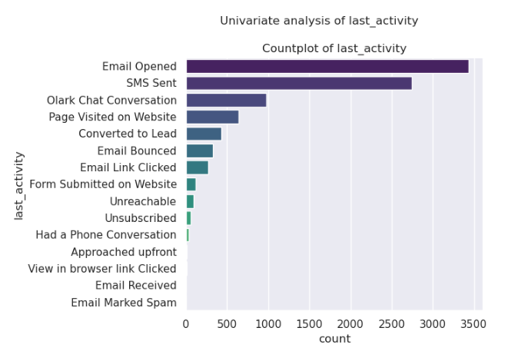
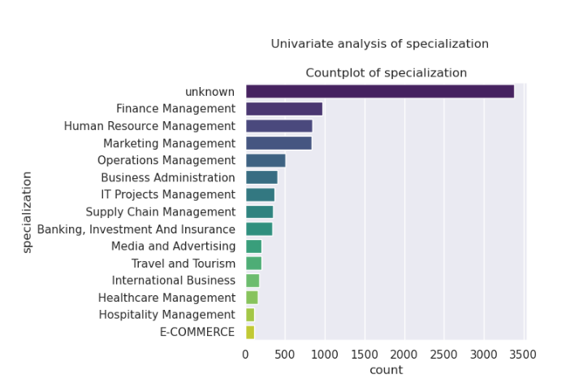
Data Visualization
univariate plots
When it comes to lead origin conversion rates, lead_add_form has higher conversion rates, holistically all have similar probability rate
WThe last activity feature majority of the users, 38% of users have email opened followed by sms sent, therefore we can say that Majority of the users are active on email conversations
Among the employed users most of the interested users have finance management as a specialization, followed by human resource management and marketing management, almost all specialization has a similar conversion rate.

Slide 14
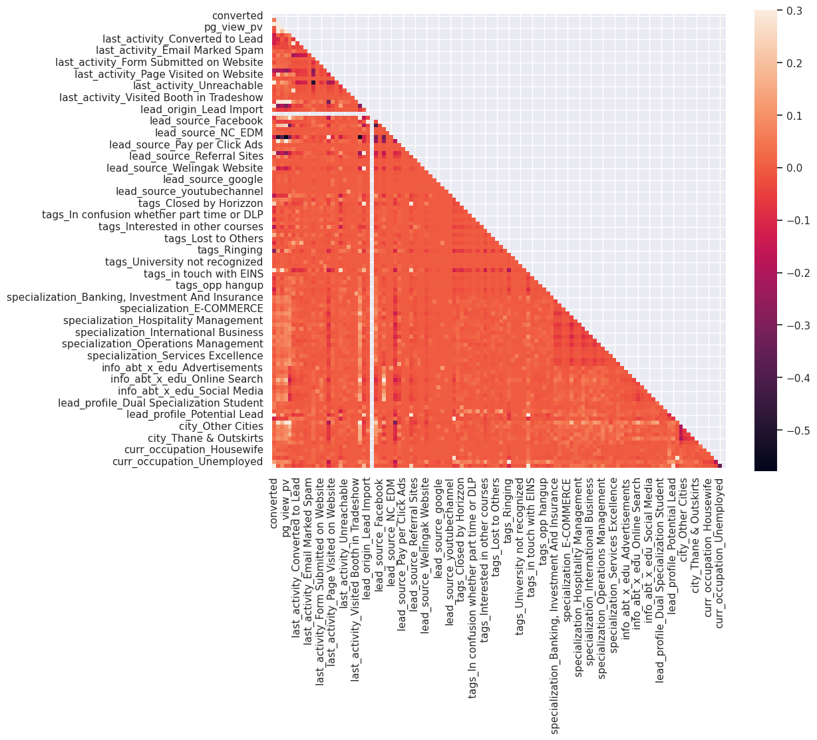
Data Visualization
Heatmap correlation
Highly correlated variable among the dummy variables is between lead_origin_Lead ImporT and lead_source_Facebook

Slide 15
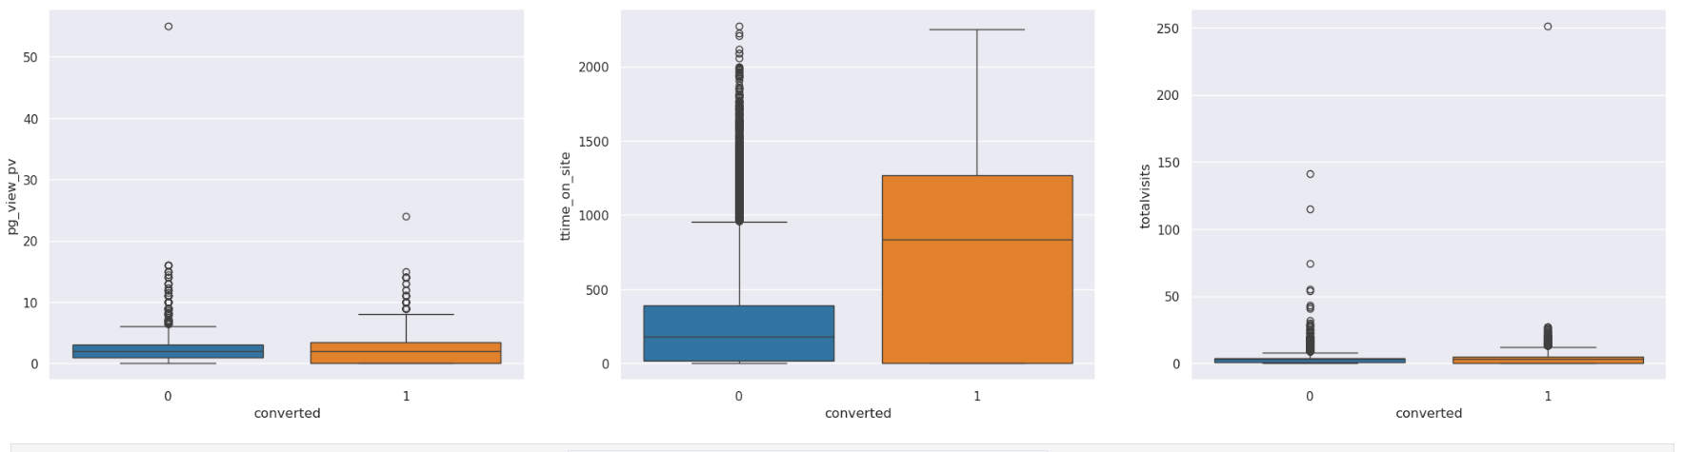
Data Visualization
Bivariate - Multivariate plots
THERE ARE NOT MUCH DIFFERENCE BETWEEN CONVERTED PG_VIEW_PV AND TOTAL VISISTS , WHEREAS CONVERTED LEADS USE TO SPENT MORE TIME ON SITE

Slide 16
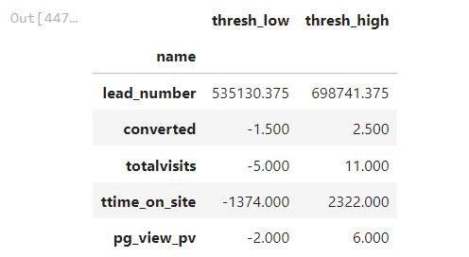
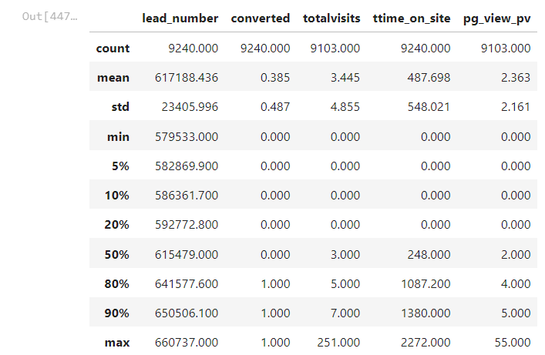
Data preprocessing part 2
Outlier Analysis and Capping
After completing outlier analysis , we did caping for outliers and the stats are shown below

Slide 17



Data preprocessing part 2
After completing eda we got four more columns which are having less than 2 % of null values , so we will drop the rows from those columns
( ‘Totalvisits’,’pg_view_pg’,’last_activity’,’lead_source’)
There are no null value column left
Data Imbalance & Conversion Ratio
From the target variable we have found out the imbalance ratios around 60 therefore we decide not to rebalance
From the target variable the conversion ratio is around 38 it shows that there is a very high probability of failure in conversion

Slide 18
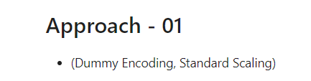

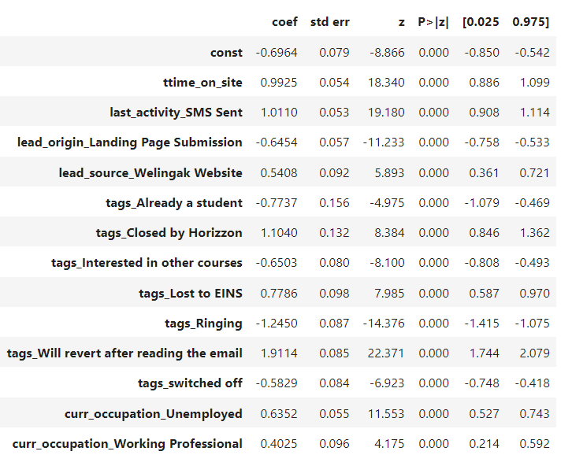
model training
we have performed dummy encoding
we have used custom functions for model training
We completed following steps in process of model building
Train and Test Split
Feature Scaling
Model Building
Base Model
RFE - Recursive Feature Elimination
Base Model
Logistic regression model : This our final model stats

Slide 19
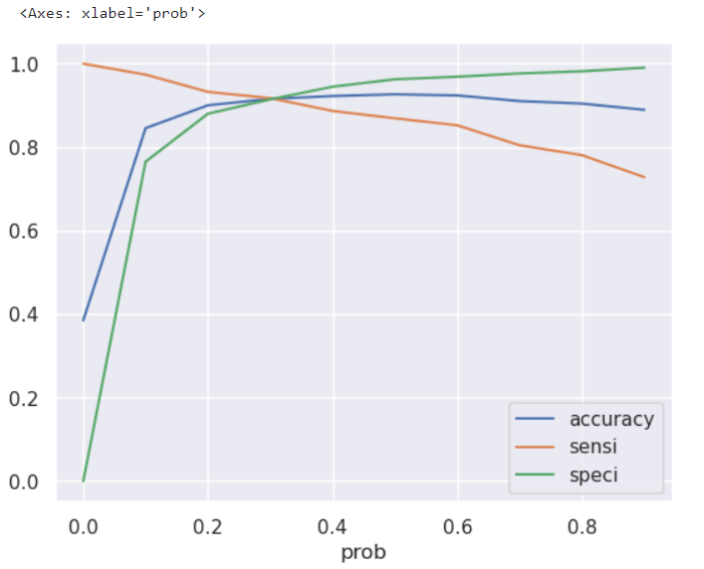
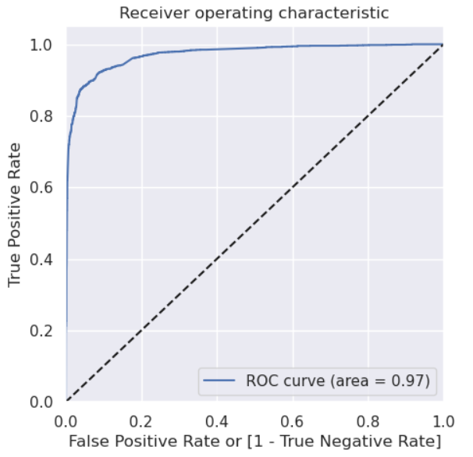
metrics comparison
We have plotted accuracy sensitivity and specificity for various probabilities.
We can see that optimal value ( cut off value) is 0.30
ROC Curve and Precision - Recall Curve
The area under the curve of the ROC is 0.97.

Slide 20
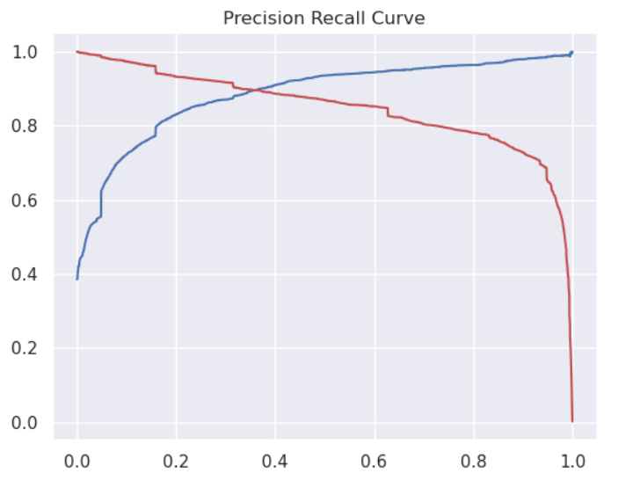
metrics comparison
We have plotted accuracy sensitivity and specificity for various probabilities.
As precision recall is having high value than sensitivity and specificity, so we used this cutoff to find out accuracy..

Slide 21
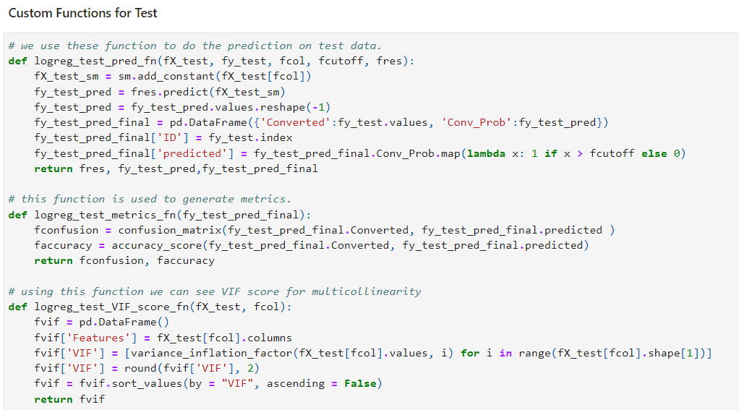
Prediction on test data
Model Validation on Test Data
We have created user defined function which will give us prediction VIF and matrix on Test Data Set

Slide 22

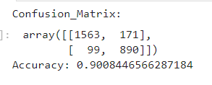
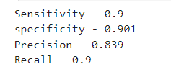
Prediction on test data
Model Validation on Test Data
Using cutoff 0.30 we calculated sensitivity specificity,accuracy , confusion matrix , precision and recall.

Slide 23


conclusion
Model Validation on Test Data
The Overall accuracy for Approach 01 is ~90%, the precision recall curve provides a higher cutoff value compared to sensitivity and specificity The metrics Sensitivity Precision are in the range the of 86 - 87% while specificity is 93%

Slide 24
THANK YOU
Vinod Yadav
Vignesh Kumar
Ujjwal Verma

